Slide 1
EEG CAP FOR DAILY APPLICATIONS
Progress Presentation
Group 23
Chang, Yue
Choi, Jung-woo
Zhao, Chen
Mentor: Patricia Widder

Slide 2
Background
EEG is…
Measure the electrical activity of the brain
Diagnosis of epilepsies, coma, and brain death
Mind-reading and mind-controlling are possible

Slide 3
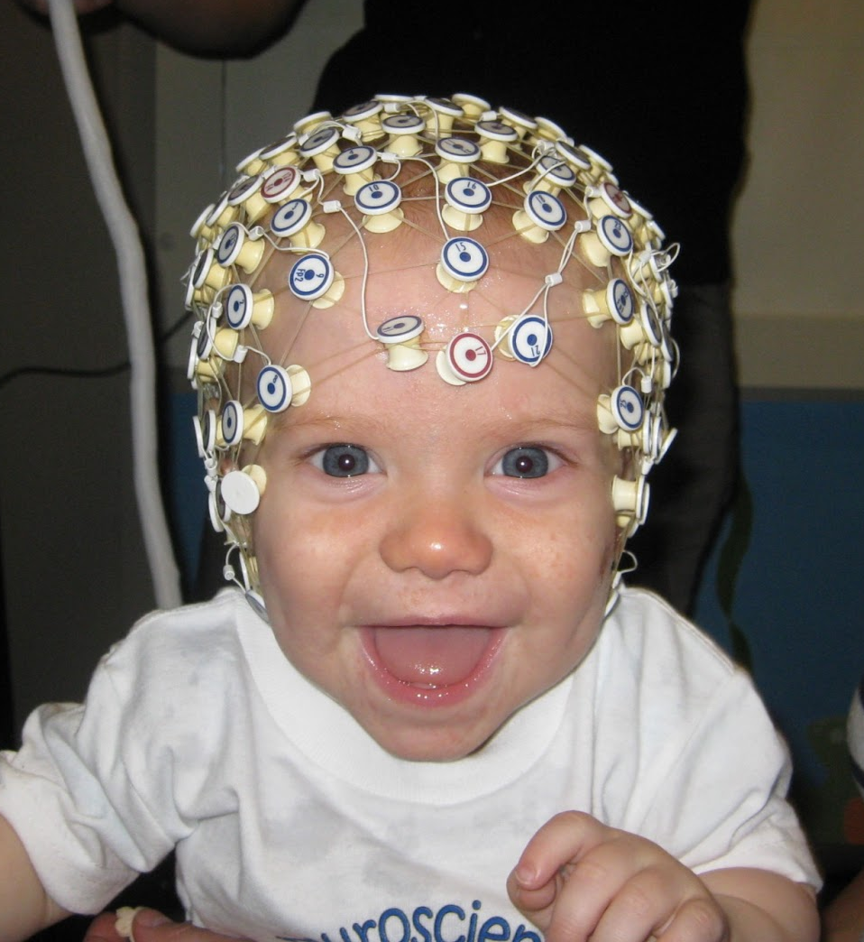
problem
Ugly
Complicated
Limited access

Slide 4
Need
Simple EEG cap
Daily use
Not only for research
Fashionable headgears
Still cover important parts

Slide 5
Specification
Mobility | Lightweight | ≤ 60 g without the electronics module ≤150 g with the electronics module
 | Smaller Headwear Size | Shorter than 3 cm of rise
 | Wireless | Enough space (2.5*3.5*0.5 cm) for Zigbee/Bluetooth wireless modules
 | Comfortability | Does not create significant physical discomfort within 8 hours of continuous wearing
Reliability | Operational Temperature | Range larger than -30~+40 °C
 | Common-mode-rejection-ratio (CMRR) of first-stage amplifier | ≥ 80dB
 | Signal-to-noise ratio (SNR) at the output | ≥ 100dB
 | Electrode life-span | ≥ 3 months with around 5 hrs of wearing time each day
 | Stable | Does not slide/shift when the user is jogging at 4 mph and sweating
 | Coverage | The standard International 10–20 system

Slide 6
Specification
Ease of Use | Set-up time for a novice user | ≤ 10 min
 | Set-up time for an experienced user | ≤ 1 min
 | Electrode Replacement (less frequent than every 3 months) | ≤ 30 min
Safety | Electricity | No active current going to the electrode; all amplifier chips insulated from the user
 | Heat dissipation | The contact surface will not rise above 35 °C
 | Impact Response | No sharp pieces produced/exposed after an external shock
Semi-Hidden Spec | Minimalistic design | Can be hidden by a cap
 | Look | More than 66% of the people are willing to wear it to a date without feeling embarrassed.

Slide 7
Design alternatives
Aesthetics
Electrode type
Topology
Construction method
3-D Printing material
Notes:
Need help here

Slide 8
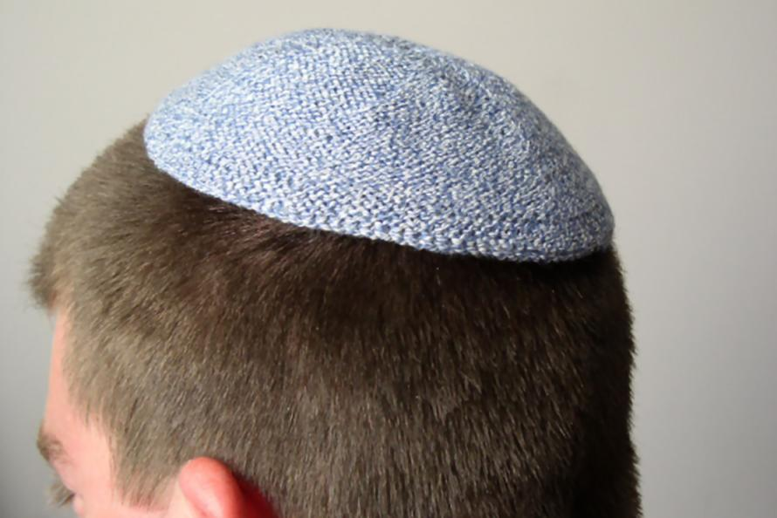
aesthetics
Fully exposed
Completely hidden
Semi-hidden
Notes:
It's hard to make a shape that will satisfy even the majority of the people. people have different hair colors and style preference.
completely hiding it is hard, especially when you need local electronics(continuously hiding something will make that thing "supposed to be hidden" by the culture like underwears)
If you wear a hat, the major parts of the frame will be hidden under the hat, but the parts beside the ear and the electronics will remain exposed (unless you wear a russian hat)

Slide 9
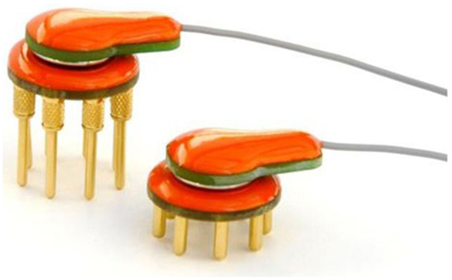
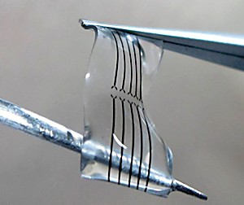
electrode
Surface electrode for sure
Dry electrode
Wet electrode
Conducting Polymer

Slide 10
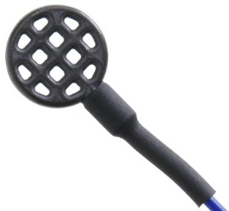
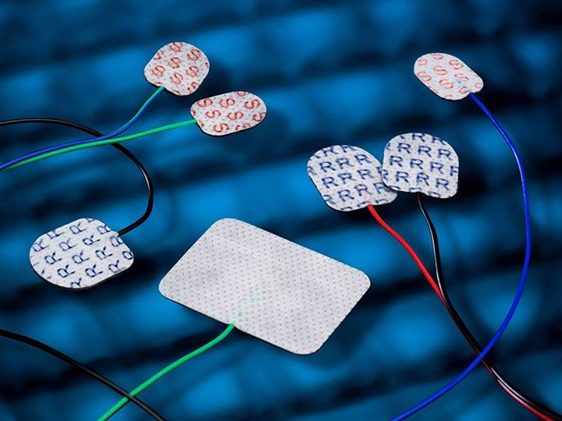
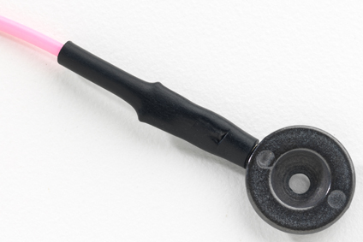
Wet electrode
Flat Electrode
Stick Pad
Disk Electrode

Slide 11
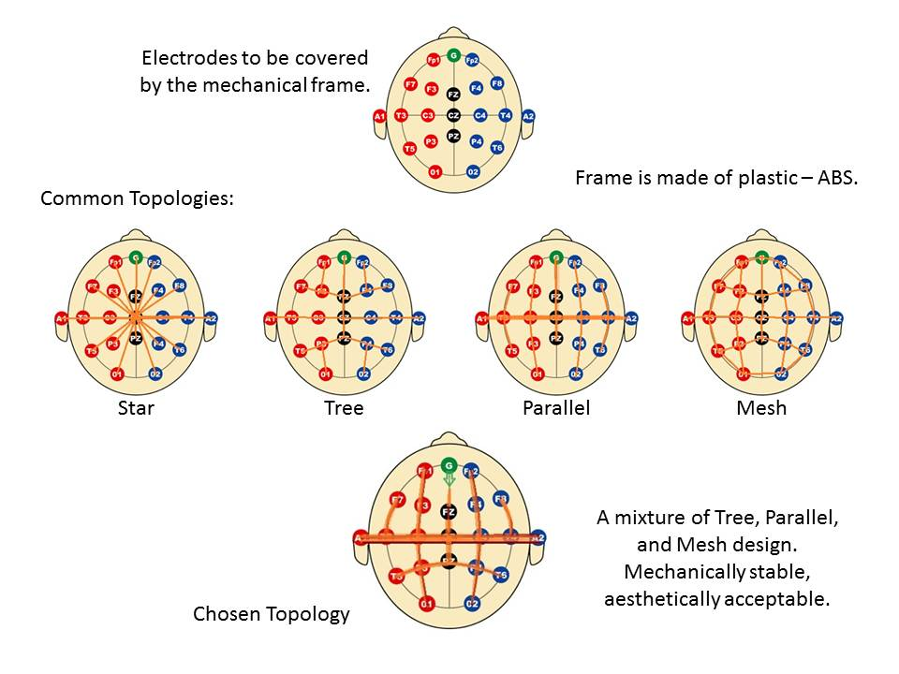
Topology

Slide 12
Construction method
Hand Crafting
  Mechanically combine all the parts
3-D Printing
  Print the whole frame as a whole

Slide 13
3-d printing materials
ABS
  Acrylonitrile Butadiene Styrene
  Preferred plastic for engineers
  Plastic odor
PLA
  Poly Lactic Acid
  Wide range of available colors
  Semi-sweet smell
  Preferred plastic for home printers or schools

Slide 14
Chosen materials
Electrode
Disposable EEG Cup Electrodes produced by Rhythmlink International, LLC
Ambu® Neuroline Cup electrode produced by Ambu A/S
Gel
Nuprep® Skin Prep Gel
Amplifier
AD8220
3-D Printer
MakerGear M-2 printer

Slide 15
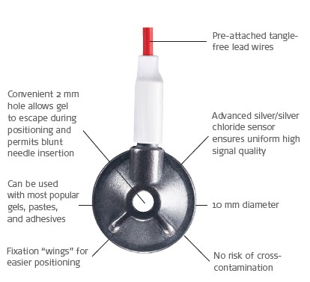
Electrode
Ambu® Neuroline Cup electrode produced by Ambu A/S
Has thin coating
Hallow design

Slide 16
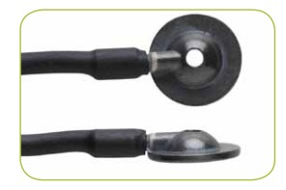
Electrode
Disposable EEG Cup Electrodes produced by Rhythmlink International, LLC
Hallow design
Non-polarized Ag/AgCl pair
Notes:
Silver / silver chloride electrodes (Ag/AgCI- electrodes) are not polarizable. Ag/AgCI- electrodes
are chloride coated pure silver to provide stability and low noise. It has a low resistance in low
frequencies that makes it suitable for this porous and prevents distortion of the EEG signals.
The shielded/unshielded cable has a length of 120cm and is equipped with a female 2mm or
male 2mm pin or dipole plug.

Slide 17
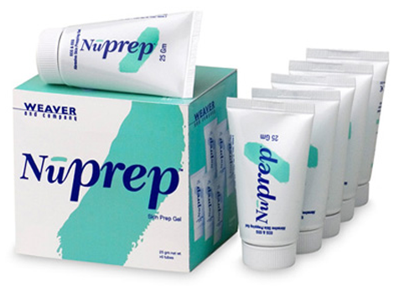
GEL
Nuprep® Skin Prep Gel produced by Weaver and Company
Widely used by the physicians doing EEG
Reduce skin impedance

Slide 18
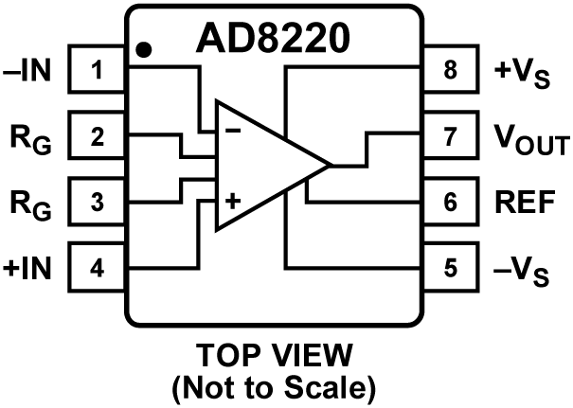
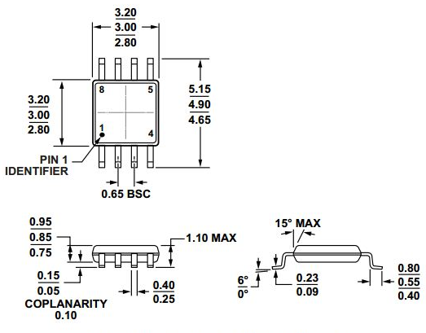
amplifier
AD8220
Differential amplifier
Very small
CMRR of 100 dB at Gain=10
Works perfectly under low power and low input currents

Slide 19
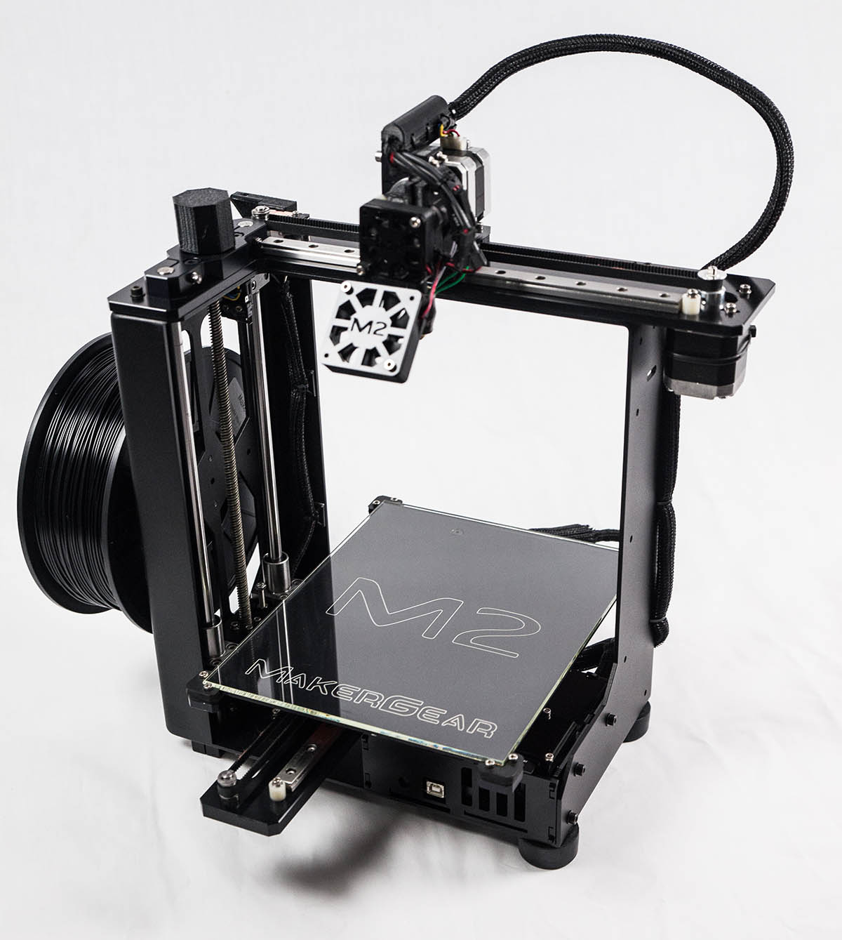
3-D PRINTER
MakerGear M-2 printer
Easy Access

Slide 20
Chosen design

Slide 21
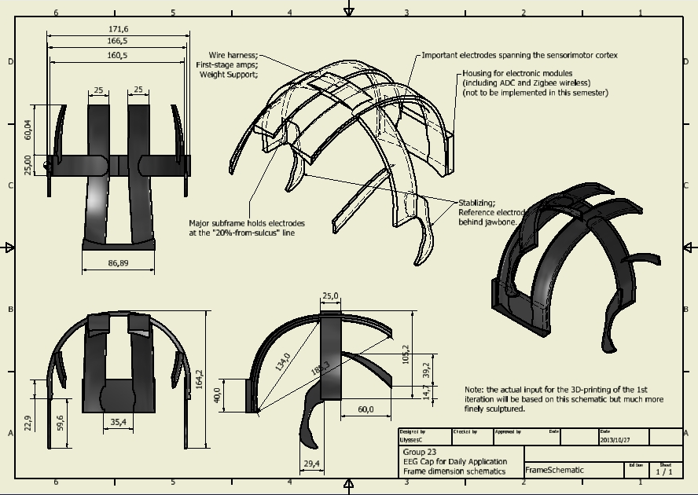
Chosen design

Slide 22
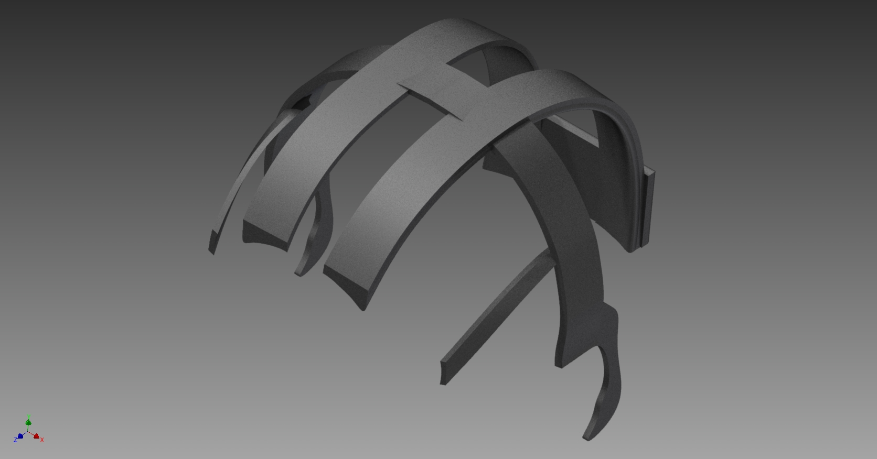
Chosen design

Slide 23
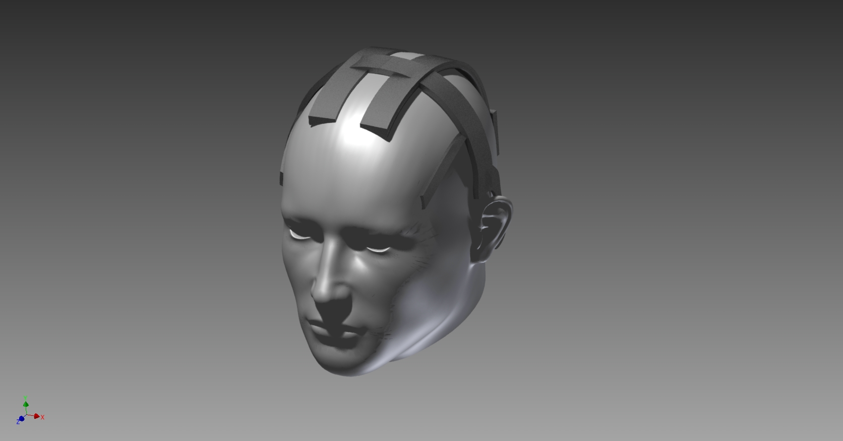
Chosen design

Slide 24
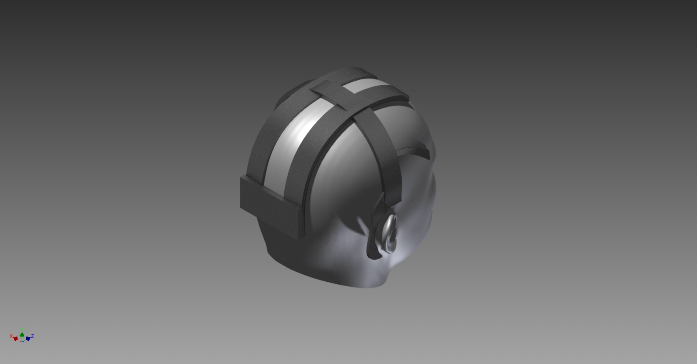
Chosen design

Slide 25
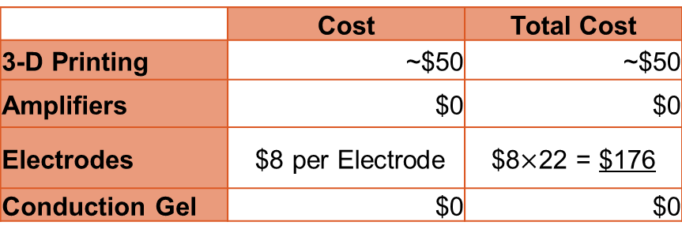
Cost analysis
For Prototyping
For Production
 | Cost | Total Cost
3-D Printing | ~$50 | ~$50
Amplifiers | $0 | $0
Electrodes | $8 per Electrode | $8$×$22 = $176
Conduction Gel | $0 | $0
 | Cost | Total Cost
Plastic Frame | Subsequent mass production will dilute the cost
Amplifiers | $5 for mass-purchase | ~$110
Electrodes | Cost is unknown for now but it will not exceed $3 per each | ~$70
Conduction Gel | Negligible | $0
Overall |  | ≤ $200 each

Slide 26
Design Schedule
Date | 10/28/2013 | 11/4/2013 | 11/11/2013 | 11/18/2013 | 11/25/2013 | 12/2/2013 | 12/9/2013 | 12/10/2013
Milestones | Progress Reports |  |  | Last Weekly Report |  | Final Reports | Final Webpage | Poster
Literature Search
Patent Search
Specifications
Web Development
Poster Design
Design
Electrode Structure
Electrode Map
Head Dimensions
DesignSafe Test
Mechanical Frame CAD File
Wiring
Wire Fixture
Hat Compatibility
3-D Printing Modifications
Prototyping
Electrode Construction
3D-Printing Frame
Pre-Amp Installation
Signal Interface
Specs Verification

Slide 27
Team organization
Yue Chang
  CAD, Literature and material search, 3-D printing, Prototype Construction, Circuit design and construction, External coordination.
Chen Zhao
  CAD, Material search, Prototype construction, Circuit design and construction, Risk analysis
Jung-woo Choi
  Group website design & maintenance, Literature and material search, Prototype construction

Slide 28
Team organization
 | CAD | Literature Search | Material Search | 3-D Printing | Prototype Construction | Circuit Design | Circuit Construction | Group Website Design & Maintenance | Risk Analysis | External Coordination
Chen Zhao
Jung-Woo Choi
Yue Chang

Slide 29
Reference
ANALOG DEVICE. JFET Input Instrumentation Amplifier with Rail-to-Rail Output in MSOP Package. N.p.: ANALOG DEVICE, n.d. Print.
EEG EMG Accessories. Coquitlam: NeuroSign, n.d. Print.
Gargiulo, Gaetano. A New EEG Recording System for Passive Dry Electrodes. Diss. The University of Sydney, 2010. N.p.: Clinical Neurophysiology, 2010. Print.
Lee, Stephen. Biopotential Electrode Sensors in ECG/EEG/EMG Systems. Diss. 2008. N.p.: Analog, 2008. Print.
Saab J. Simultaneous EEG Recordings with Dry and Wet Electrodes in Motor-Imagery. Diss. Graduate School of Neural and Behavioural Sciences - International Max Planck Research School, n.d. N.p.: n.p., n.d. Print.
Tallgren P. Evaluation of Commercially Available Electrodes and Gels for Recording of Slow EEG Potentials. Diss. University of Helsink, 2004. Helsinki: University Hospital of Helsinki, 2004. Print.
Electrode sets http://www.cortechsolutions.com/Products/DA/DA-AT/DA-AT-ES
THE DIFFERENCE BETWEEN ABS AND PLA FOR 3D PRINTING http://www.protoparadigm.com/blog/2013/01/the-difference-between-abs-and-pla-for-3d-printing/
ABS AND PLA FOR 3D PRINTING http://blog.naver.com/jcmr?Redirect=Log&logNo=10168672308

Slide 30
Questions?

